Slide 1

Being in the shoes of an online buyer
Pedro Felix Andrei IV
Teodoro Emily Grace

Slide 2






Slide 3



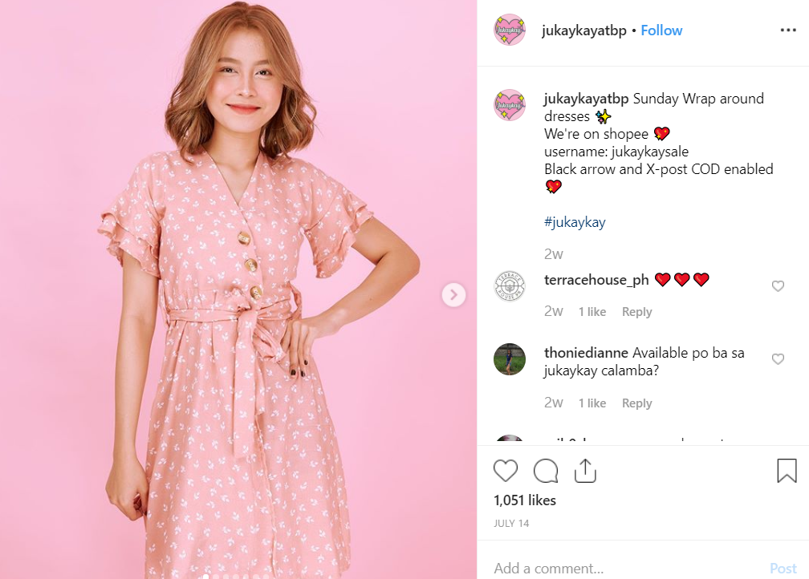
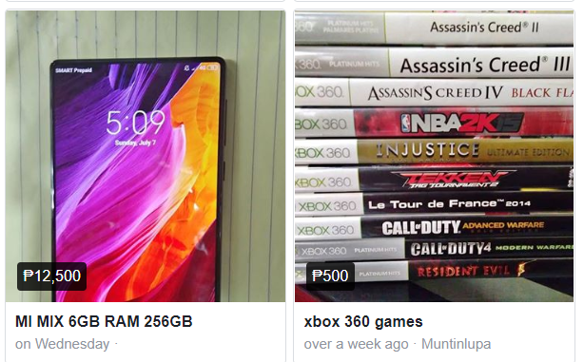


Slide 4
Observation

